Slide 1
Our Solution For Plastic Pollution
By Eco Squad

Slide 2
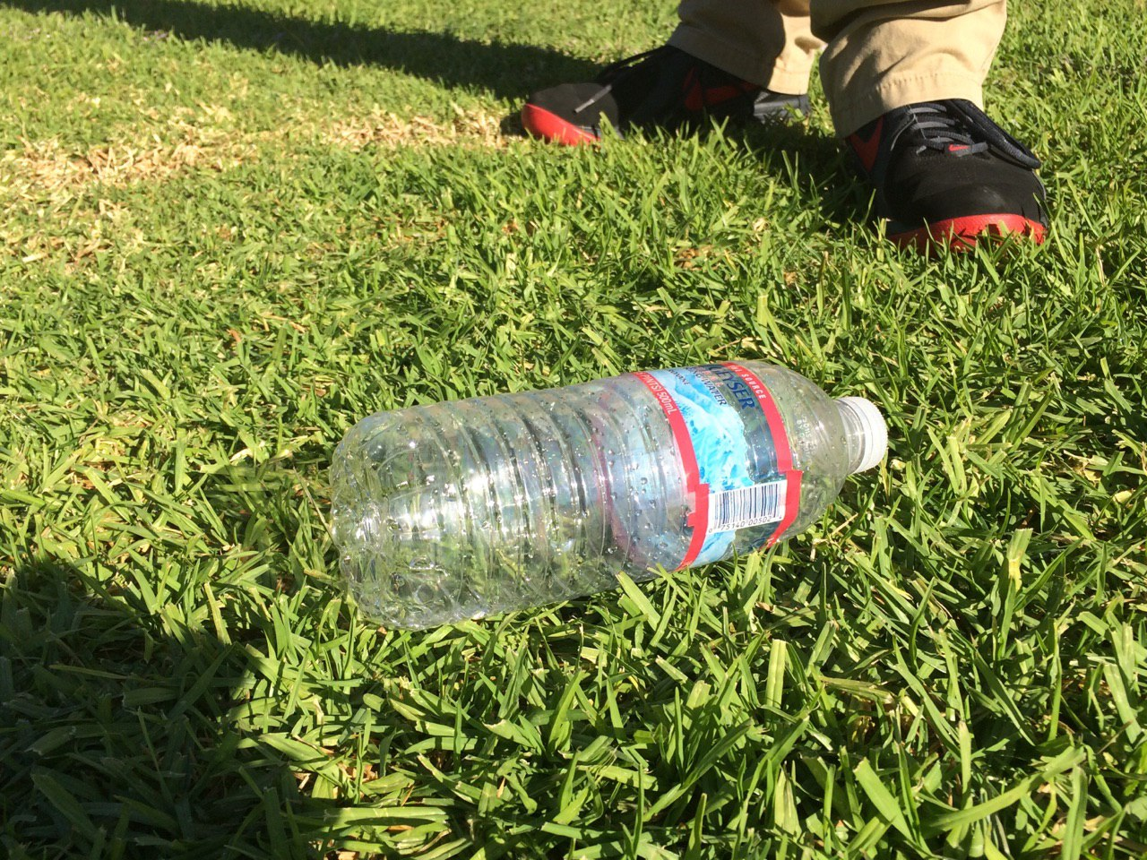
Our Action Plan
Eco Squad developed an action plan that will help our community in reducing plastic water bottle waste.
Our team installed water bottle filling station and

