Slide 1
The Eco Squad
Nature is beautiful, lets keep it that way, together.

Slide 2
Our Mission:
To help keep our schools and the environment clean and free of plastic pollution by reducing plastic usage, starting on our campus.

Slide 3
Plastic pollution
30
Plastic pollution has been a major problem for decades.
Since 1960, the amount of plastic pollution in California has increased exponentially, reaching 30 million tons by 2005.
24
Tons of plastic wasted (in millions)
10
1
1960 | 1985 | 2000 | 2005
Year

Slide 4
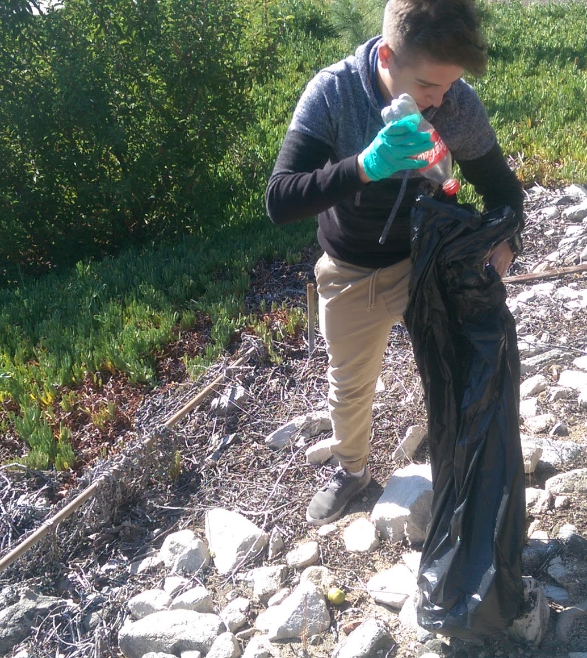
Minimizing Plastic Pollution
A large part of plastic pollution can be attributed to plastic water bottles. The Eco Squad wants to bring an end to the use of plastic water bottles, by encouraging the use of reusable ones. So we worked with Elkay and the district to bring Clark a new and improved water fountain, with a reusable bottle refilling station and built-in cooler.

Slide 5
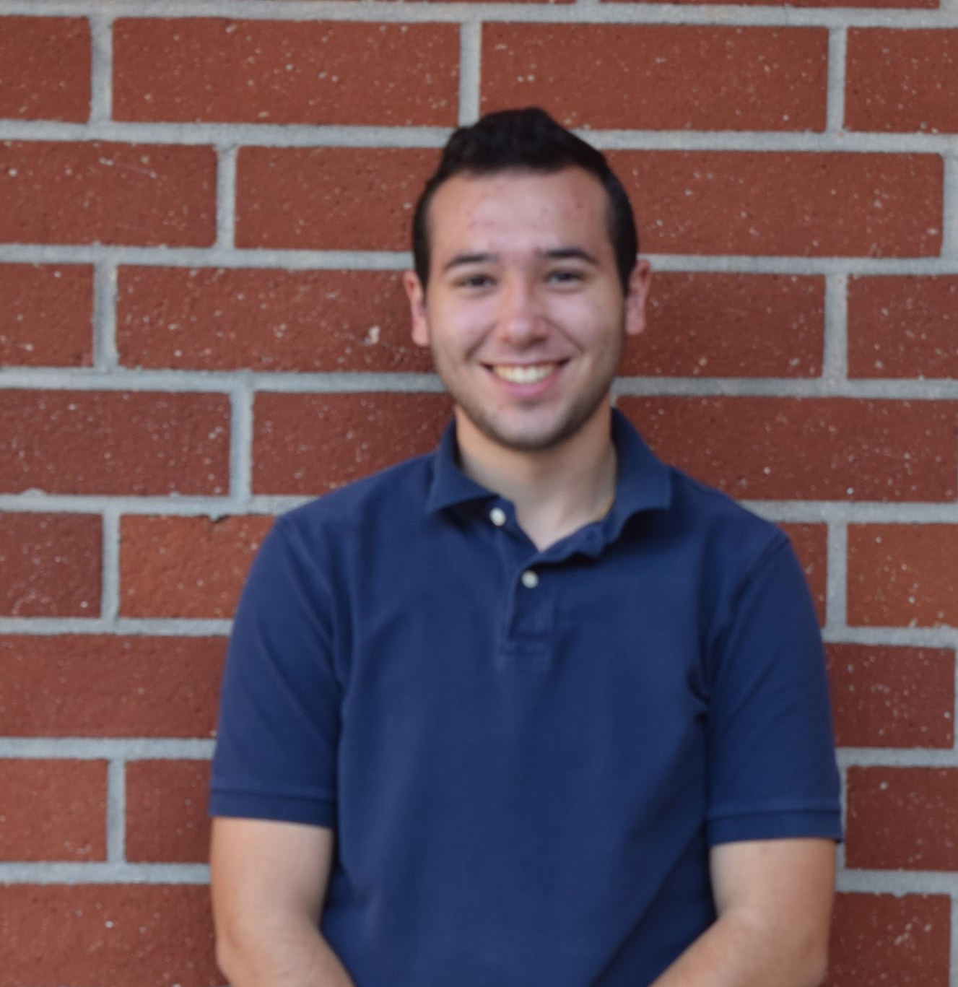
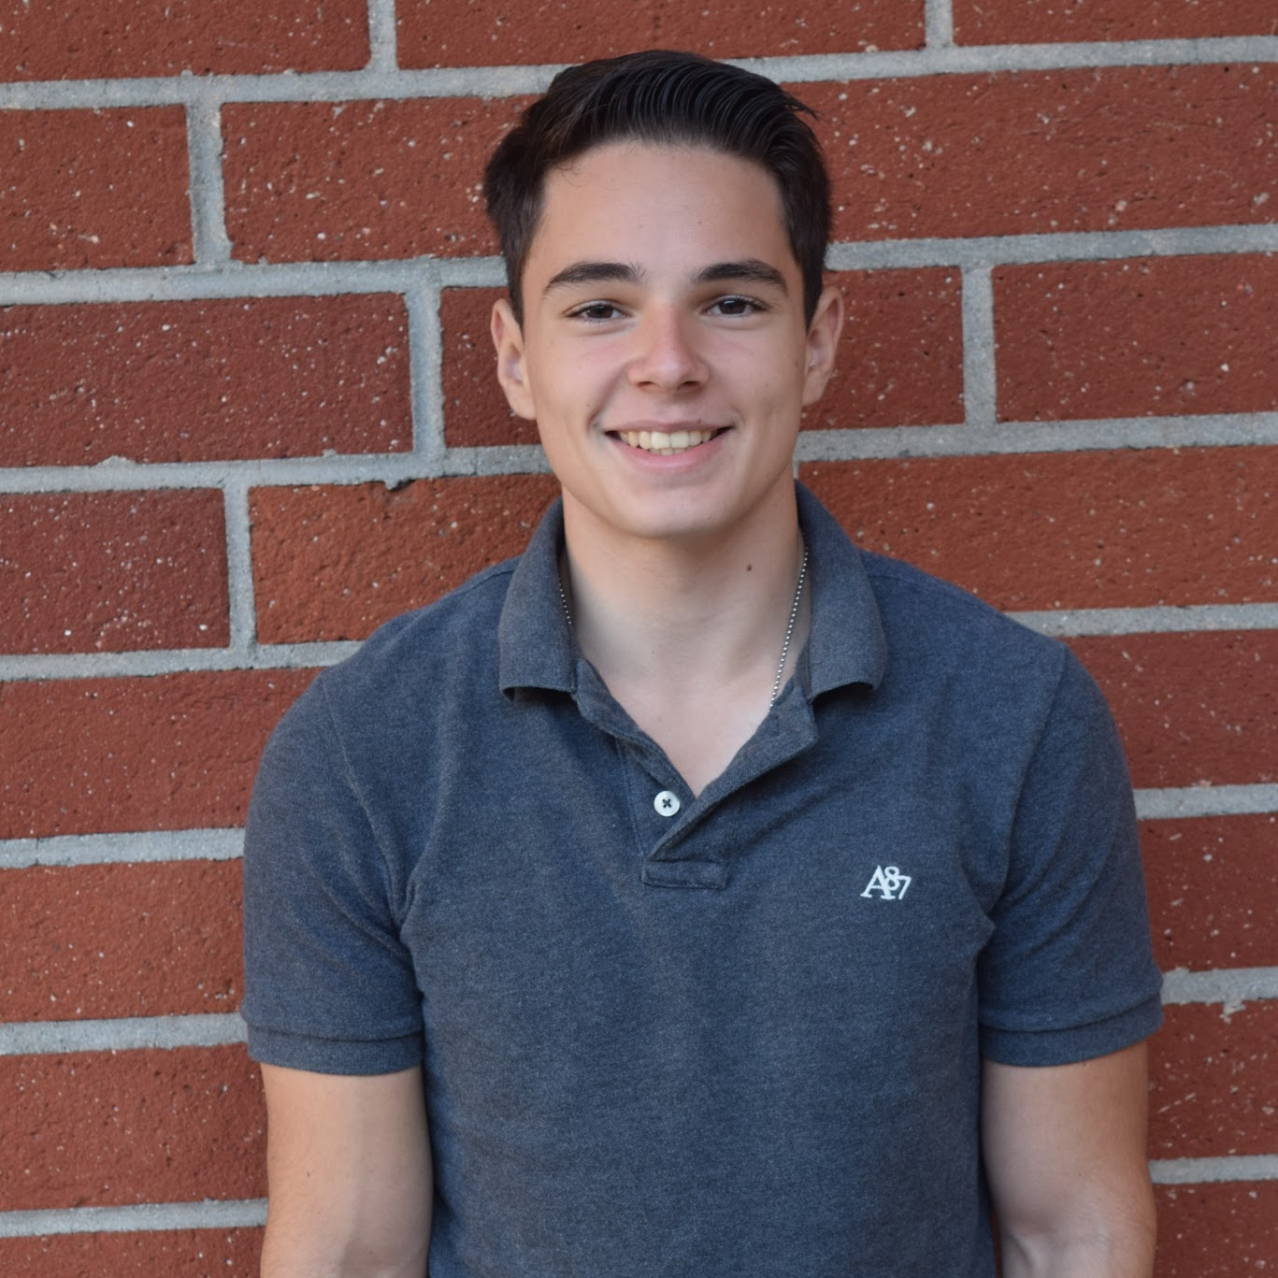
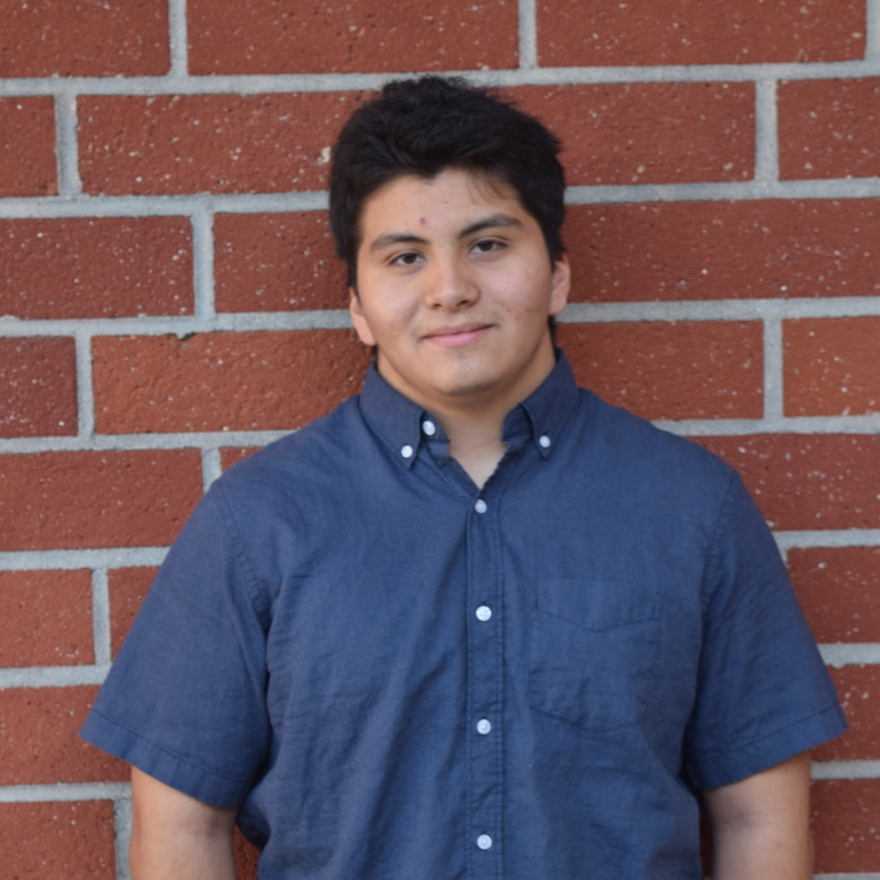
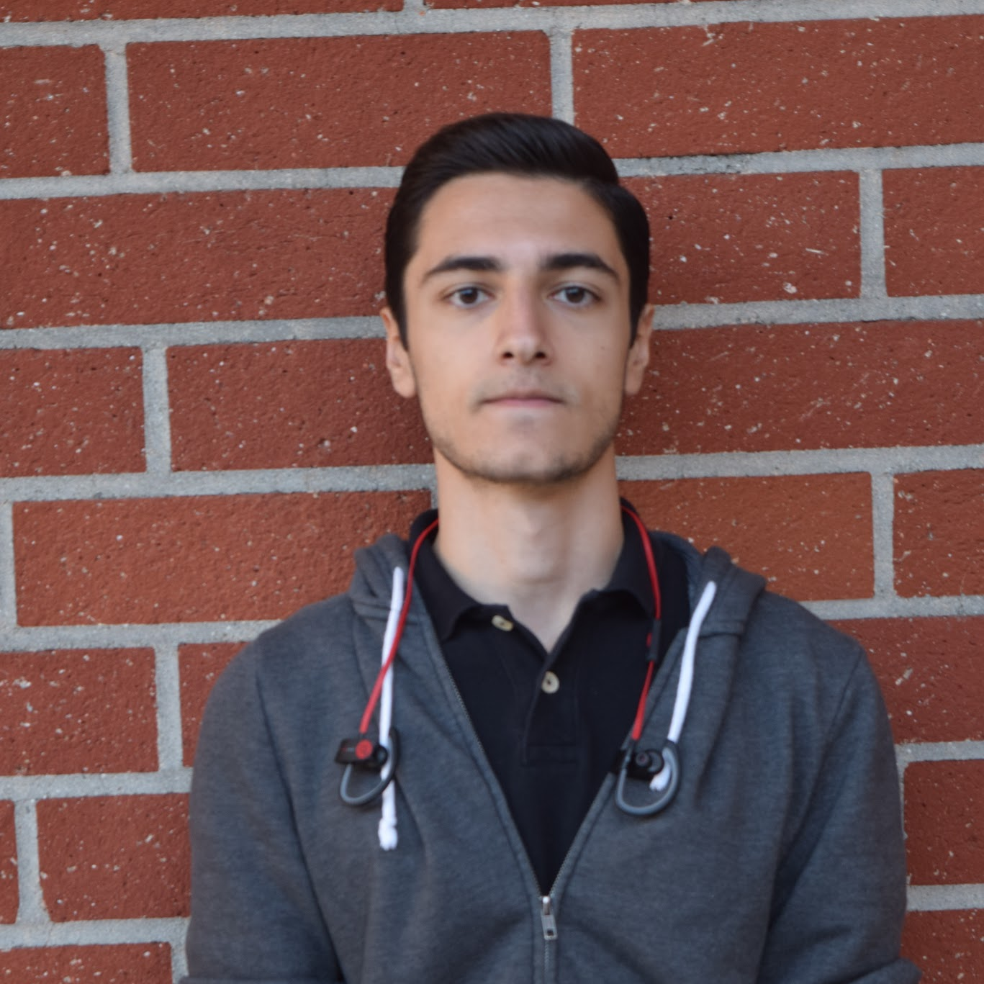
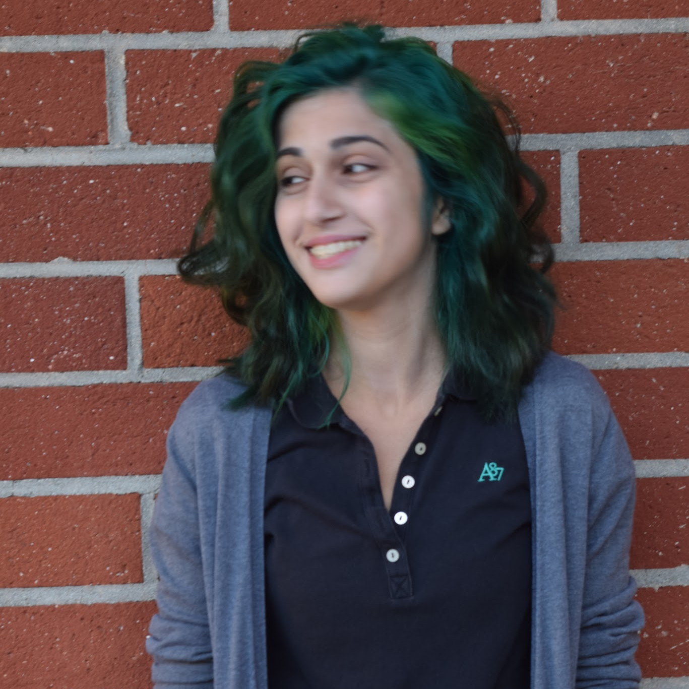
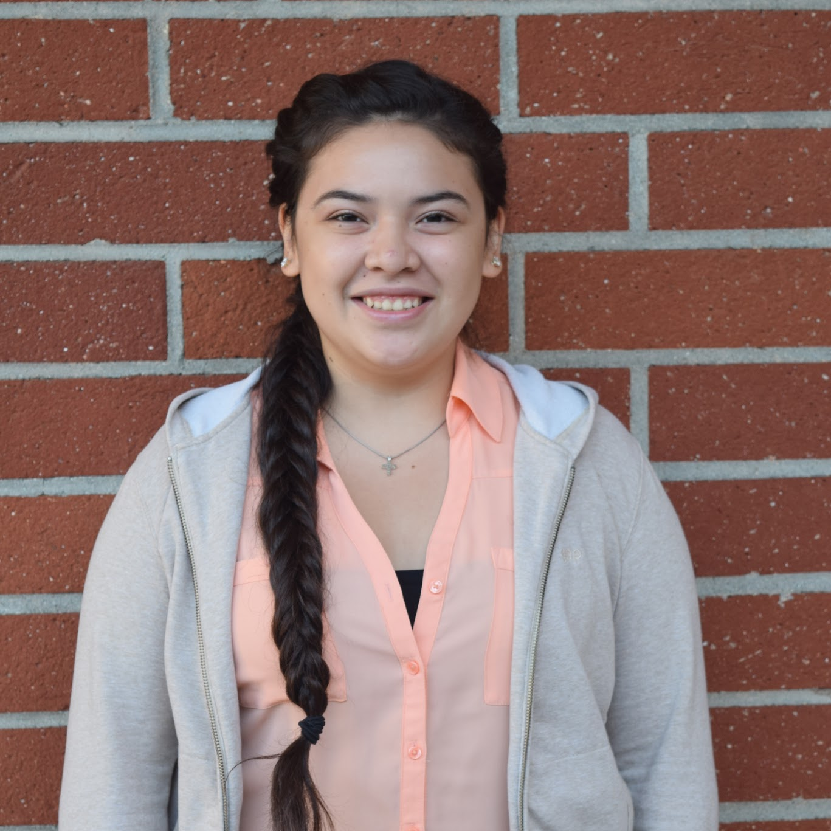
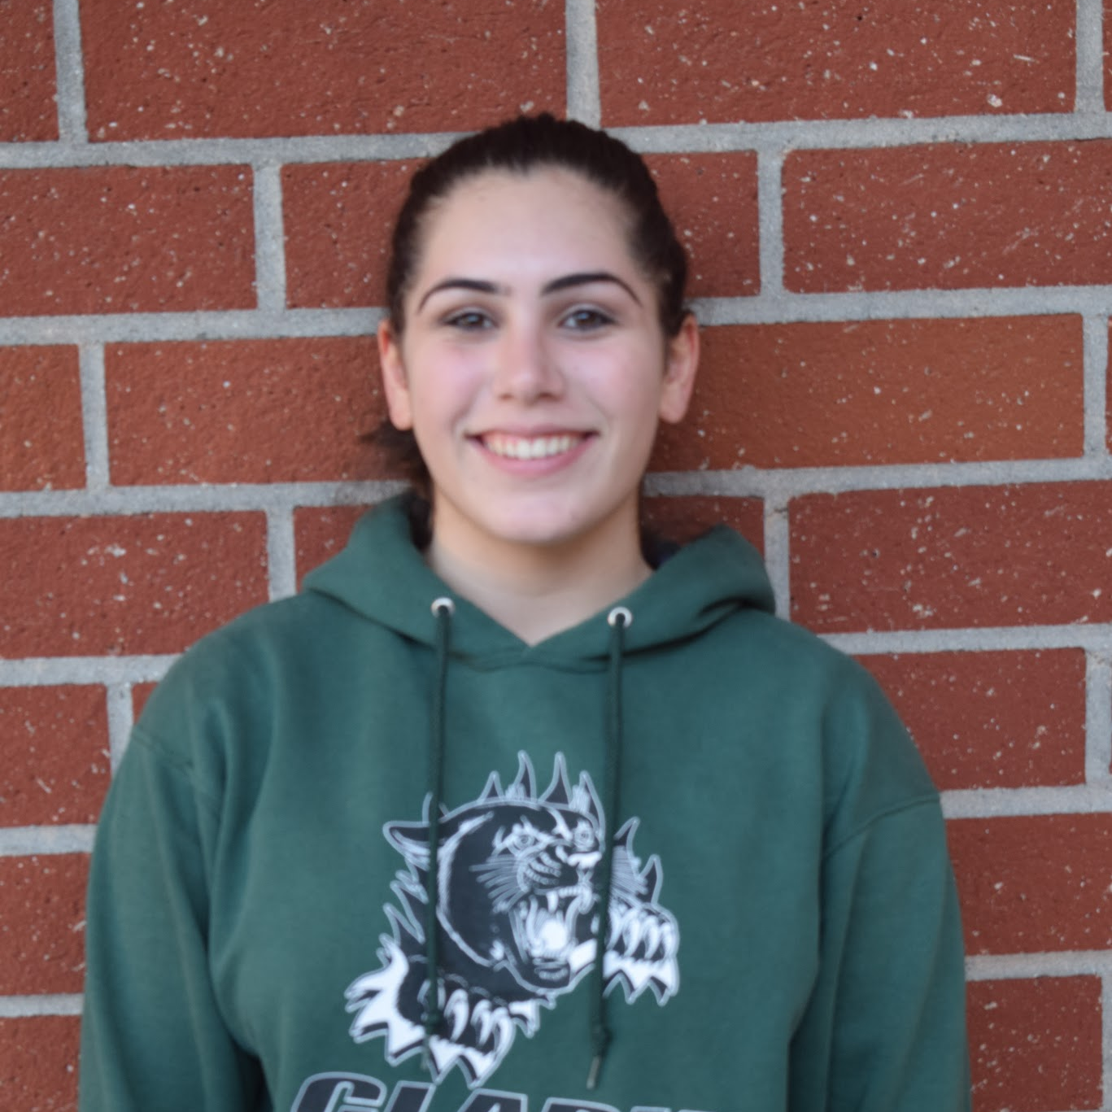
The Eco Squad
John B.
Leon A.
Demetrio R.
Dro V.
Karina K.
Michelle H.
Armineh M.
Project Manager John Bandek
Assistant Project Manager Leon Arapi
Public Representative Demetrio Rebollo
Public Representative Dro Vasghanian
Project Coordinator Karina Khachaturova
Graphic Designer Michelle Hernandez
Graphic Designer Armineh Moradian

Slide 6
Milestones
August 2016
October 2016
December 2016
September 2016
November 2016
September 2016
Social media outreach begins. Donors Choose page launched.
Elkay unit installed. Action Plan and website finalized.
The Eco Squad was founded
Results of Lexus Eco Challenge pending.
Aug |  | Sep |  |  | Oct | Nov |  |  | Dec
The Elkay unit was purchased and prepared for installation
Results of Lexus Eco Challenge pending.

Slide 7
Appendix
How much will this project actually help with plastic waste?
How is this station superior to the previous one?
What will happen to the other station?
Why is Leon Arapi so darn handsome?
Q/A:

Slide 8
How it works
Step 3
Step 2
Step 1
Throw-away plastic water bottle usage goes down, plastic waste reduced.
Reusable water bottles passed out and promoted
Elkay station installed

Slide 9
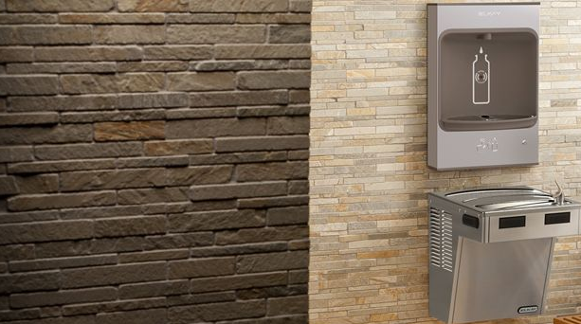
The Technology:
Elkay’s refilling stations incorporate state of the art motion sensor technology to make the process easy and hands-off. The fountain includes a cooler, which will be powered by clark’s solar panels, making it even more green.

Slide 10
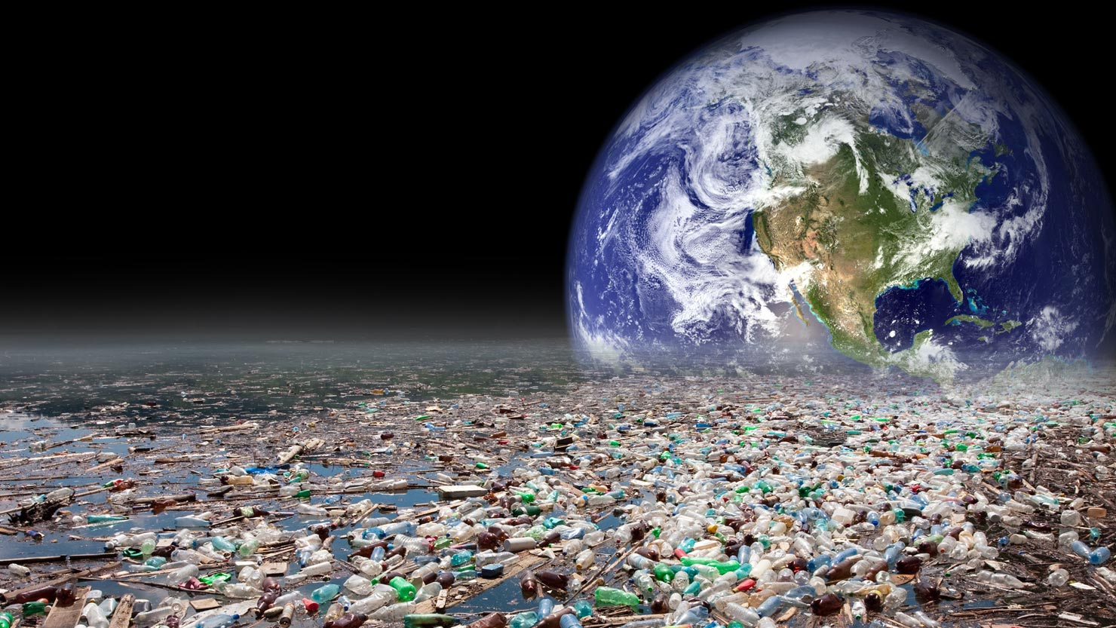
Why now?
50 billion plastic water bottles are used yearly, and out of that only 23% are recycled. This means that over $1 billion worth of plastic is wasted every year. Making enough water bottles to fill the demands of the US takes over 17 million barrels of oil annually, without including the oil used in transportation. Thats enough to power 1.3 million cars for a year.

