Slide 1
Plastic on the Planet

Slide 2
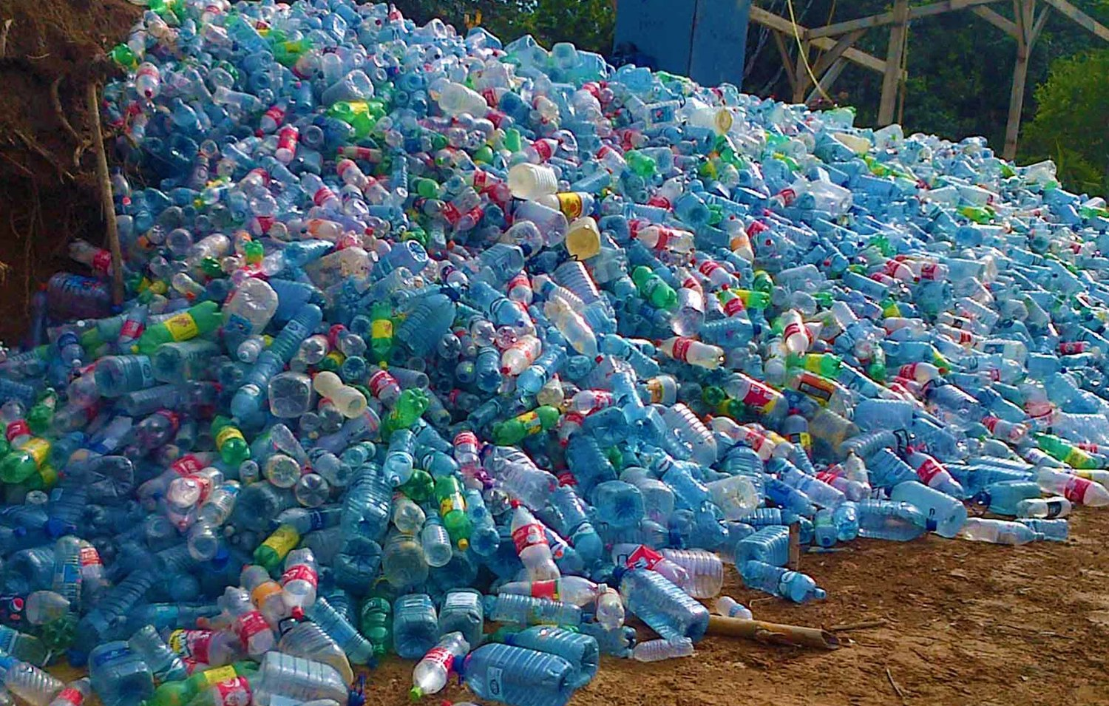
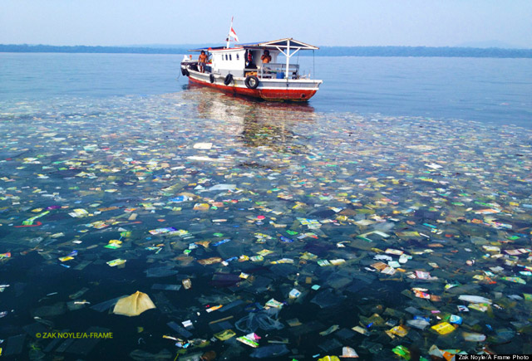
What do we mean by plastics?
We mean plastic, of all kinds from plastic. From water bottles, to bags, which enter the ocean and are later torn apart by currents. Which can devastate the deep sea ecosystems.
Source

Slide 3
Hello!
We are the Eco Squad
We are here to educate on plastic pollution to increase understanding in the public.
You can find us at our Website, Instagram, Twitter, and contact our Email.

Slide 4
Why plastics?
?
We always talk about pollution, we just want to focus on something everyone could help with more than they thought before.

Slide 5
“Americans throw away 35 billion plastic water bottles every year” (source: Brita)

Slide 6
What's so bad about plastic?
Well Plastic:
Is ingested by fishes, who are eaten by us
Are foreign to underwater environments and cause damage
Example: Whale killed by DVD case
Source

Slide 7
Plastic
Its a problem we can help solve, by teaching others about the problem and doing our parts.

