Slide 1
S.W.O.T- Level Two

Slide 2
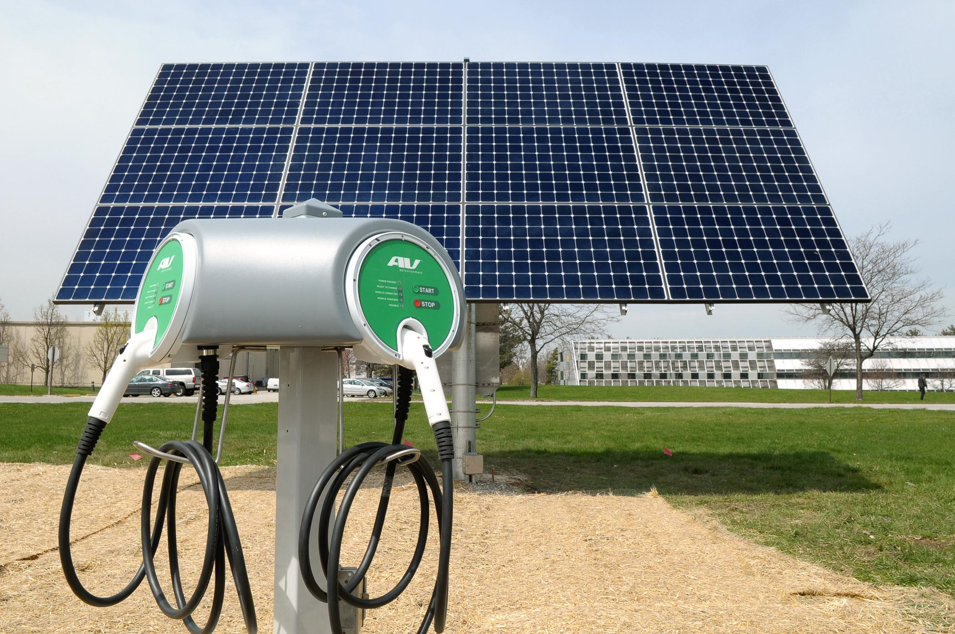
1
AeroVironment electric car charging station
$800 - $2000

Slide 3
Strengths
Easy to use, flashes green when it’s ready to go
Long cord for reducing installation costs
Safe for installation and use outdoors as well as indoors
Recycling Act of 2003 helps us with funding to reduce electronic waste
Great amount of choices when it comes to which unit to buy

Slide 4
Weaknesses
Cheaper stations can’t charge multiple cars simultaneously
It’s a hard wired model
Needs to be near a energy source
Only 15 ft, so an electric only spot is necessary

Slide 5
Opportunity
It can be an incentive for more electric cars
Be an effective use of our solar panels
Can be an outlet for students and administration to work more cohesively
Could have more funding come to the school by means of associating our school with companies
Seniors with an electric car could park at the teacher parking lot

Slide 6
Threats
An unreasonable sum of capital needed for hill/slope installation
A lack of security in this project, (northern gate allows random people to walk by)
A power outage may harm the hardware/vehicle attached
Compatible with most models, but not all

Slide 7
Conclusion

