Slide 1
Stopping Plastic Pollution
By: Eco SQUAD

Slide 2
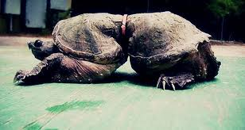
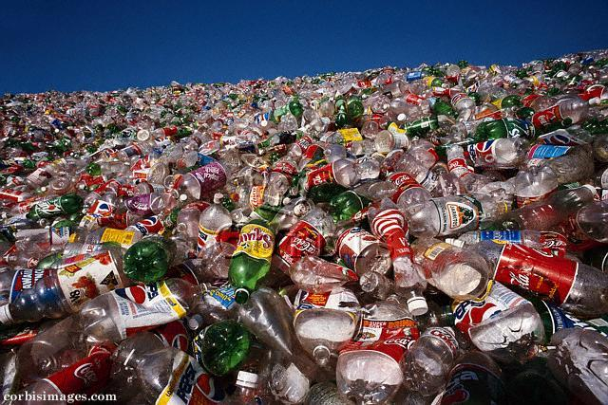
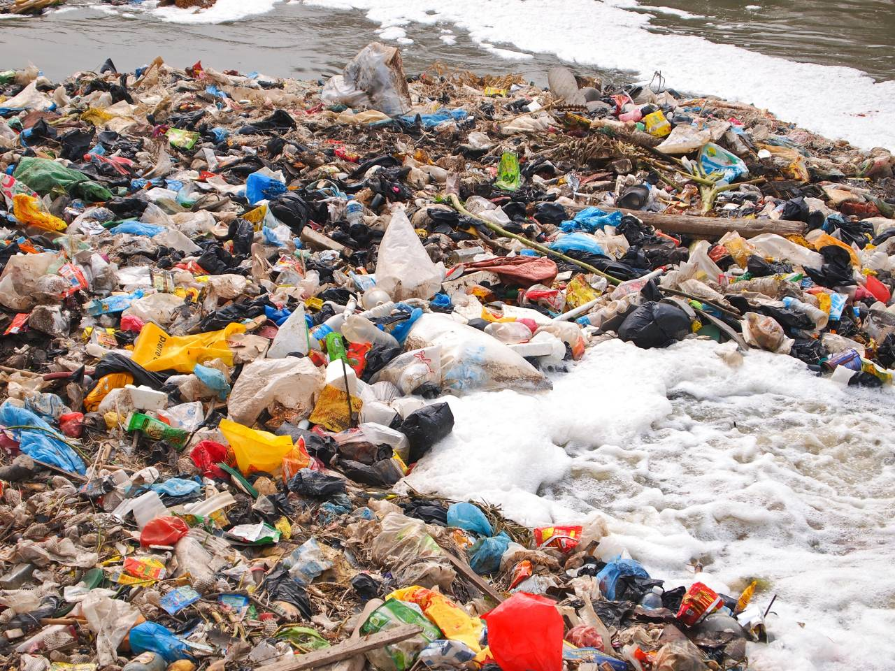
The Plastic Problem
35 billion plastic bottles are thrown away in the US alone
500 billion plastic bags are used annually worldwide
Over 250 known species have been harmed by plastic waste
Estimated 7 trillion a year of economic risk from plastic pollution

Slide 3
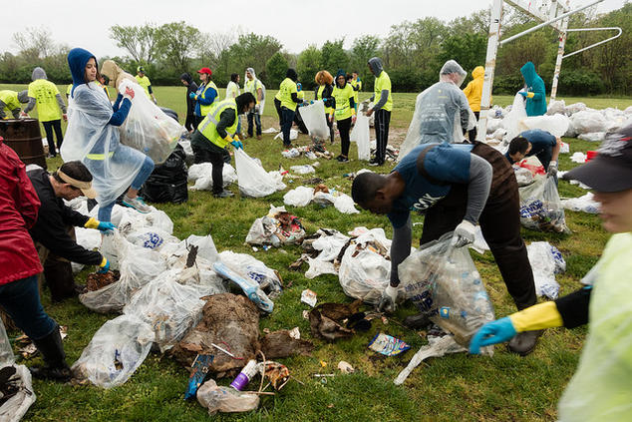
Can We Stop Plastic Pollution?
Some organizations made to fight plastic pollution
Example: NRDC
NRDC cleans up trash, takes legislative action against plastic use in California
Spend roughly 428 million annually to stop/ clean up pollution

Slide 4
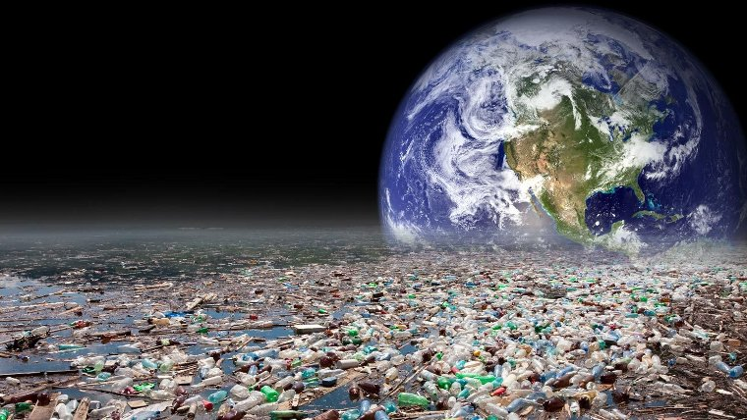
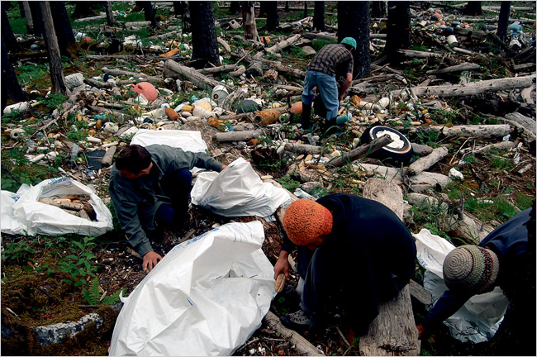
How Much is Enough?
This issue affects us on a global scale
Communitywide efforts have been made, but they’re not nearly enough to significantly reduce the planet-wide pollution
We can’t rely on a single organization to clean the whole planet, it's impossible
Every little bit help counts
If we work together as a planet, we could end plastic waste pollution for good

Slide 5
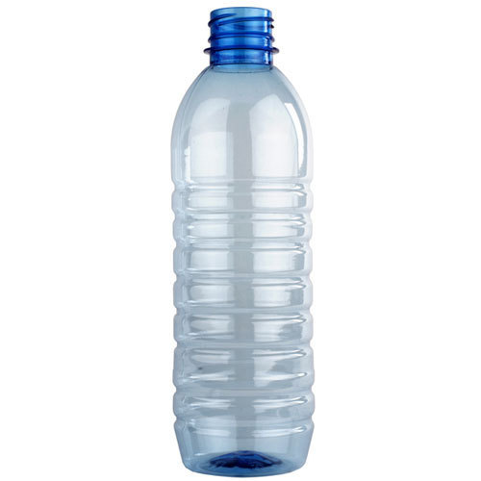
What Can YOU Do?
Use reusable items ie: plates, cutlery, bags, bottles, etc.
Stop buying bottled water
Purchase second-hand items ie: from thrift stores
Support a plastic bag tax or ban
Put pressure on plastic manufacturers any way possible
Every little bit counts

